Slide 1

GAYATRI VIDYA PARISHAD
COLLEGE FOR DEGREE AND PG COURSES(A)
(Affiliated to Andhra University | Accredited by NAAC with " B++" Grade | ISO 9001: 2015)
Visakhapatnam-530045.
A Cryptographic Algorithm Based on ASCII and Number System Conversions along with
A Cyclic Mathematical Function
Project By MCA 4th semester
Name : Bendi Satya Pavan
Rollno : PG212202006
Project Guide By
Sir. B. DIVAKAR
ASSISTANT PROFESSOR

Slide 2
CONTENTS
Abstract
Introduction
Existing system
Proposed system
Algorithm
Example
Functional Requirements
Non-Functional Requirements
Use-case diagram for Sender and Receiver
Sequence diagram for Sender
Sequence diagram for Receiver
State chart diagram for Sender
State chart diagram for Receiver
Conclusion

Slide 3
ABSTRACT
Data encryption and decryption in an efficient manner are the challenging aspects of modern information theory. In this algorithm, the plaintext to be encrypted is converted into unprintable characters. For encryption, a different technique is applied based on ASCII and number system conversions, which makes this algorithm different from others. First, each character of the plaintext and secret key is converted into its equivalent ASCII (decimal). Then, using some matrix manipulations on the decimal, representation of each character is transformed to 4 unprintable characters. After that, every unprintable character in the intermediate cipher text is further converted into a different unprintable character using a cyclic mathematical function. Performing three steps of processing, the final encrypted message is produced that gives higher level of security.
.

Slide 4
INTRODUCTION
Cryptography, Steganography and watermarking are three popular modern security offering techniques.
Among them, the cryptography is older and mostly used technique as it is easy to implement and offers higher level of security.
The cryptography is the study of mathematical techniques related to the aspects of information security such as confidentiality, data integrity, entity authentication and data origin authentication.
Cryptography historically dealt with the construction and analysis of protocols that would prevent any third parties from reading a private communication between two parties.
In the digital age, cryptography has evolved to address the encryption and decryption of private communications through the Internet and computer systems.
On the other hand, decryption is the reverse procedure that moves from the unintelligible cipher text back to plaintext.

Slide 5
EXISTING SYSTEM
In Existing system there are many cryptographic algorithms are introduced. One of the earliest and most used mechanisms in cryptography is Caesar's cipher which is also called a shift cipher. It is a replacement mechanism in which each letter of the plain text is replaced by another letter which is certain places ahead of the letter and the process is repeated for all the letters in the plain text. The number of places ahead to be used is the key to the encryption. For example, if the key is 2, then a will be replaced by c which is two places ahead of a. In this project, a new cryptographic algorithm is proposed which involves ASCII, number system conversions and the cyclic mathematical used .

Slide 6
PROPOSED SYSTEM
Day by day the level of security is going to be higher. Still now many researchers are working on cryptography and data hiding. A new cryptographic algorithm for the Real Time Application was in to improve the time for encryption and decryption of data of end-to-end delay and to provide higher level of security. I proposed an improved algorithm which is different from the traditional symmetric-key cryptography, asymmetric-key cryptography or hashing function. A cryptographic algorithm based on ASCII conversion and a cyclic mathematical function was presented in, and which makes the cipher different from other algorithms.

Slide 7
ENCRYPTION ALGORITHM
Steps in Algorithm
Input message.
Convert to ASCII values
Input Key1 message
Convert to ASCII values
Find the product
Convert the product into binary and put the bits on a 4×4 matrix from last to first.
Read the bits from each column and make decimal.
We get four decimal values in New_ASCII array.
Input Key2 value (m)
calculate Final_ASCII [i] = (New_ASCII +m) % 32, where,0<m<32
Convert the Final_ASCII[i] into its equivalent character.
End encryption.

Slide 8
ENCRYPTION EXAMPLE
Let’s take a message “SATYA”
And Key is “PAVAN”
Both are converted to ASCII values
After Calculate Product
Then Convert to Binary values
Plain Text | ASCII | Key1 | ASCII | Product | Binary
S | 83 | P | 80 | 6640 | 1 1001 1111 0000
A | 65 | A | 65 | 4225 | 1 0000 1000 0001
T | 84 | V | 86 | 7224 | 1 1100 0011 1000
Y | 89 | A | 65 | 5785 | 1 0110 1001 1001
A | 65 | N | 78 | 5070 | 1 0011 1100 1110

Slide 9
ENCRYPTION EXAMPLE
Encryption of ‘S’ |  |  |  |  | Encryption of ‘A’ |  |  |  |  | Encryption of ‘T’ |  |  |  |  | Encryption of ‘Y’ |  |  |  |  | Encryption of ‘A’
4x4 matrix is |  |  |  |  | 4x4 matrix is |  |  |  |  | 4x4 matrix is |  |  |  |  | 4x4 matrix is |  |  |  |  | 4x4 matrix is
0 | 0 | 0 | 1 |  | 0 | 0 | 0 | 1 |  | 0 | 0 | 0 | 1 |  | 0 | 0 | 0 | 1 |  | 0 | 0 | 0 | 1
1 | 0 | 0 | 1 |  | 0 | 0 | 0 | 0 |  | 1 | 1 | 0 | 0 |  | 0 | 1 | 1 | 0 |  | 0 | 0 | 1 | 1
1 | 1 | 1 | 1 |  | 1 | 0 | 0 | 0 |  | 0 | 0 | 1 | 1 |  | 1 | 0 | 0 | 1 |  | 1 | 1 | 0 | 0
0 | 0 | 0 | 0 |  | 0 | 0 | 0 | 1 |  | 1 | 0 | 0 | 0 |  | 1 | 0 | 0 | 1 |  | 1 | 1 | 1 | 0
Transpose of the matrix |  |  |  |  | Transpose of the matrix |  |  |  |  | Transpose of the matrix |  |  |  |  | Transpose of the matrix |  |  |  |  | Transpose of the matrix
0 | 1 | 1 | 0 |  | 0 | 0 | 1 | 0 |  | 0 | 1 | 0 | 1 |  | 0 | 0 | 1 | 1 |  | 0 | 0 | 1 | 1
0 | 0 | 1 | 0 |  | 0 | 0 | 0 | 0 |  | 0 | 1 | 0 | 0 |  | 0 | 1 | 0 | 0 |  | 0 | 0 | 1 | 1
0 | 0 | 1 | 0 |  | 0 | 0 | 0 | 0 |  | 0 | 0 | 1 | 0 |  | 0 | 1 | 0 | 0 |  | 0 | 1 | 0 | 1
1 | 1 | 1 | 0 |  | 1 | 0 | 0 | 1 |  | 1 | 0 | 1 | 0 |  | 1 | 0 | 1 | 1 |  | 1 | 1 | 0 | 0
New ASCII |  |  |  |  | New ASCII |  |  |  |  | New ASCII |  |  |  |  | New ASCII |  |  |  |  | New ASCII
6 | 2 | 2 | 14 |  | 2 | 0 | 0 | 9 |  | 5 | 4 | 2 | 10 |  | 3 | 4 | 4 | 11 |  | 3 | 3 | 5 | 12
Final ASCII=(A+K)%32 |  |  |  |  | Final ASCII=(A+K)%32 |  |  |  |  | Final ASCII=(A+K) %32 |  |  |  |  | Final ASCII=(A+K) %32 |  |  |  |  | Final ASCII=(A+K) %32
11 | 7 | 7 | 19 |  | 7 | 5 | 5 | 14 |  | 10 | 9 | 7 | 15 |  | 8 | 9 | 9 | 16 |  | 8 | 8 | 10 | 17
Encrypted characters |  |  |  |  | Encrypted characters |  |  |  |  | Encrypted characters |  |  |  |  | Encrypted characters |  |  |  |  | Encrypted characters
; | ) | ) | ] |  | ) | & | & | > |  | / | + | ) | ? |  | * | + | + | @ |  | * | * | / | [
Finally, the plaintext “SATYA” is encrypted as cipher text
;))])&&>/+)?*++@**/[

Slide 10
Mapping Table
0 | 1 | 2 | 3 | 4 | 5 | 6 | 7
! | ‘ | # | $ | % | & | ( | )
8 | 9 | 10 | 11 | 12 | 13 | 14 | 15
* | + | / | ; | < | = | > | ?
16 | 17 | 18 | 19 | 20 | 21 | 22 | 23
@ | [ | \ | ] | ^ | { | | | }
24 | 25 | 26 | 27 | 28 | 29 | 30 | 31
~ | × | – | Ø | © | ® | ± | µ

Slide 11
DECRYPTION ALGORITHM
Steps in Algorithm
1) Browse Cipher text
2) Convert to values
3) Browse Key2 value
4) Calculate the formula
Final ASCII=(A-K+32) mod 32
5) Each value is convert to binary
6) Then all the binary values arrange in 4x4 matrix
7) Transpose the matrix
8) Each 4×4 matrix is convert to binary value
9) And Key1 from Sender is PAVAN
10) Key is Convert to ASCII values
11) Then Divide each Decimal value by Key values
12) Then values are Plain Text

Slide 12
DECRYPTION EXAMPLE
Cipher text ;))])&&>/+)?*++@**/[
And the key is 5 from sender
Encrypted characters |  |  |  |  | Encrypted characters |  |  |  |  | Encrypted characters |  |  |  |  | Encrypted characters |  |  |  |  | Encrypted characters
; | ) | ) | ] |  | ) | & | & | > |  | / | + | ) | ? |  | * | + | + | @ |  | * | * | / | [
ASCII values |  |  |  |  | ASCII values |  |  |  |  | ASCII values |  |  |  |  | ASCII values |  |  |  |  | ASCII values
11 | 7 | 7 | 19 |  | 7 | 5 | 5 | 14 |  | 10 | 9 | 7 | 15 |  | 8 | 9 | 9 | 16 |  | 8 | 8 | 10 | 17
Final ASCII= (A-K+32) mod 32 |  |  |  |  | Final ASCII= (A-K+32) mod 32 |  |  |  |  | Final ASCII= (A-K+32 ) mod 32 |  |  |  |  | Final ASCII= (A-K+32) mod 32 |  |  |  |  | Final ASCII= (A-K+32) mod 32
6 | 2 | 2 | 14 |  | 2 | 0 | 0 | 9 |  | 5 | 4 | 2 | 10 |  | 3 | 4 | 4 | 11 |  | 3 | 3 | 5 | 12
4x4 matrix is |  |  |  |  | 4x4 matrix is |  |  |  |  | 4x4 matrix is |  |  |  |  | 4x4 matrix is |  |  |  |  | 4x4 matrix is
0 | 1 | 1 | 0 |  | 0 | 0 | 1 | 0 |  | 0 | 1 | 0 | 1 |  | 0 | 0 | 1 | 1 |  | 0 | 0 | 1 | 1
0 | 0 | 1 | 0 |  | 0 | 0 | 0 | 0 |  | 0 | 1 | 0 | 0 |  | 0 | 1 | 0 | 0 |  | 0 | 0 | 1 | 1
0 | 0 | 1 | 0 |  | 0 | 0 | 0 | 0 |  | 0 | 0 | 1 | 0 |  | 0 | 1 | 0 | 0 |  | 0 | 1 | 0 | 1
1 | 1 | 1 | 0 |  | 1 | 0 | 0 | 1 |  | 1 | 0 | 1 | 0 |  | 1 | 0 | 1 | 1 |  | 1 | 1 | 0 | 0
Transpose of the matrix |  |  |  |  | Transpose of the matrix |  |  |  |  | Transpose of the matrix |  |  |  |  | Transpose of the matrix |  |  |  |  | Transpose of the matrix
0 | 0 | 0 | 1 |  | 0 | 0 | 0 | 1 |  | 0 | 0 | 0 | 1 |  | 0 | 0 | 0 | 1 |  | 0 | 0 | 0 | 1
1 | 0 | 0 | 1 |  | 0 | 0 | 0 | 0 |  | 1 | 1 | 0 | 0 |  | 0 | 1 | 1 | 0 |  | 0 | 0 | 1 | 1
1 | 1 | 1 | 1 |  | 1 | 0 | 0 | 0 |  | 0 | 0 | 1 | 1 |  | 1 | 0 | 0 | 1 |  | 1 | 1 | 0 | 0
0 | 0 | 0 | 0 |  | 0 | 0 | 0 | 1 |  | 1 | 0 | 0 | 0 |  | 1 | 0 | 0 | 1 |  | 1 | 1 | 1 | 0

Slide 13
Decryption Example
Each 4×4 matrix is convert to binary value
And Key1 from Sender is PAVAN
Key is Convert to ASCII values
Then Divide each Decimal value by Key values
Binary | Convert to Decimal | Key1 | ASCII | Decimal ASCII | Plain Text
1 1001 1111 0000 | 6640 | P | 80 | 83 | S
1 0000 1000 0001 | 4225 | A | 65 | 65 | A
1 1100 0011 1000 | 7224 | V | 86 | 84 | T
1 0110 1001 1001 | 5785 | A | 65 | 89 | Y
1 0011 1100 1110 | 5070 | N | 78 | 65 | A
The decryption procedure of the other characters from the cipher text is “SATYA”

Slide 14
Functional Requirements
Encryption
Input : Plain text,
Keys(s) : Random Key value.
Output : Cipher text.
Decryption
Input : Cipher text,
Key(s) : Get Key .
Output : Plain text.

Slide 15
Functional Requirements
Hardware Requirements
Processor : Intel i3 & Above
RAM : 4 GB
Hard disk : 500 GB
Keyboard : Standard 102 Keys
Mouse : Standard
Software Requirements:
Operating system : Windows 7 & Above
Front-end/GUI tool : Python IDLE 3.10.4.
Programming language : Python Programming

Slide 16
Non-Functional Requirements
Usability: The GUI of this system provides easy access to the user and user can get best results for the given input.
Supportability: System is implemented using Python 3.8.3 IDLE.
Performance: It display the correct result based on the output for all possible correct inputs at all times when the computer is in proper condition.
Reliability: This system will perform its intended function adequately for a specific period of time.
Maintainability: This system can adapt any technology and can detect errors.
Portability: This system can work on windows operating system environment with minimal changes.

Slide 17
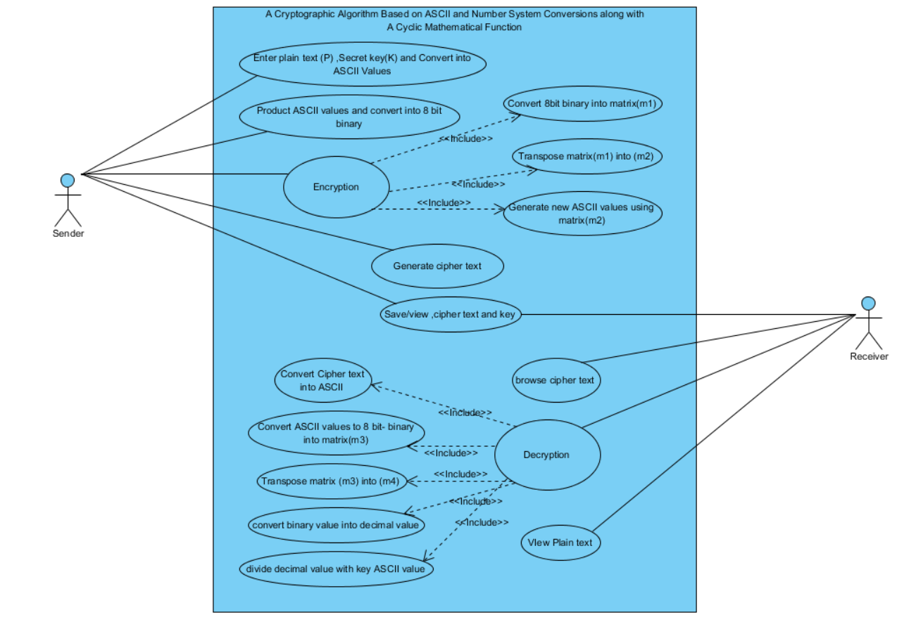
Use-case diagram for Sender and Receiver

Slide 18
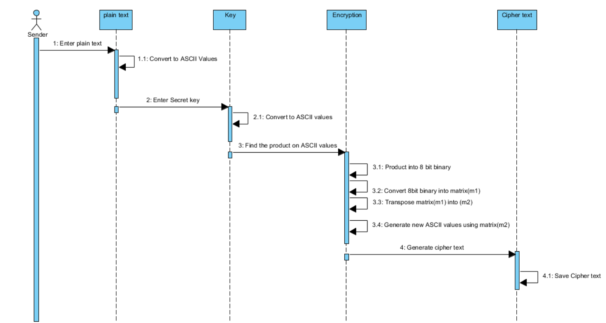
Sequence diagram for Sender

Slide 19
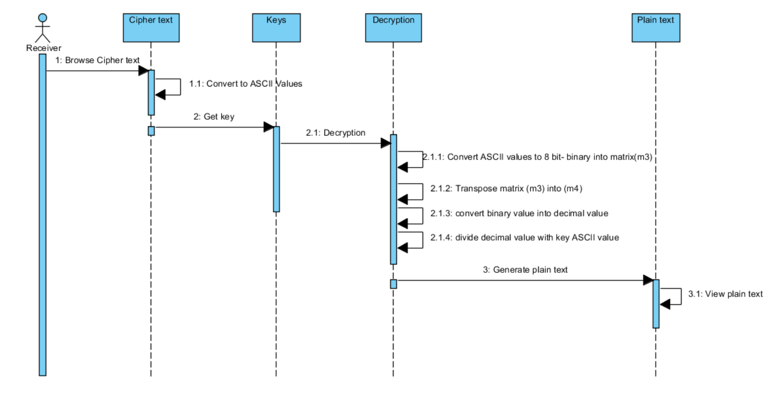
Sequence diagram for Receiver

Slide 20
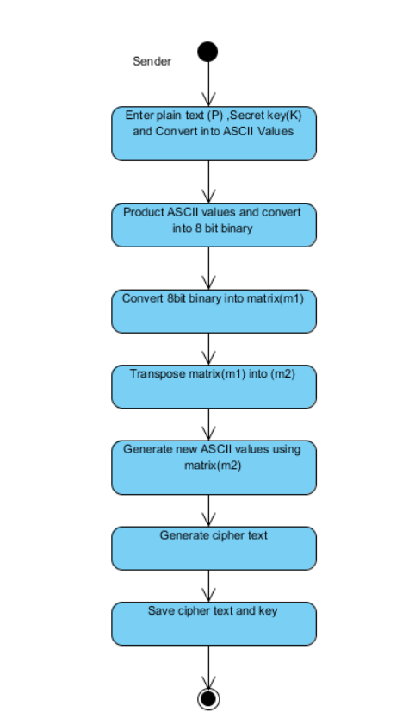
State chart diagram for Sender

Slide 21
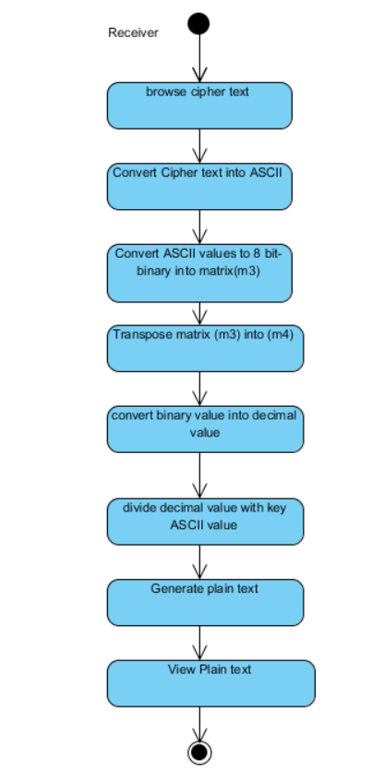
State chart diagram for Receiver

Slide 22
CONCLUSION
To ensure higher security and to hide data in effective way the proposed algorithm contributes greatly. Here, we present an algorithm which is based on ASCII conversion and number system conversion and a cyclic mathematical function. This algorithm not only encrypts the data but also hides the data which gives more security. In future we will try to increase the security technique and implement some real time security system and try to add steganography with the system.

Slide 23


